Slide 1
Funbid
Web Information System
Group 4:
- Trần Tùng Dương
- Lê Xuân Hưng
- Nguyễn Ngọc Quý

Slide 2
Outline
System overview
System architecture
Project installation
Teamwork
Demo

Slide 3
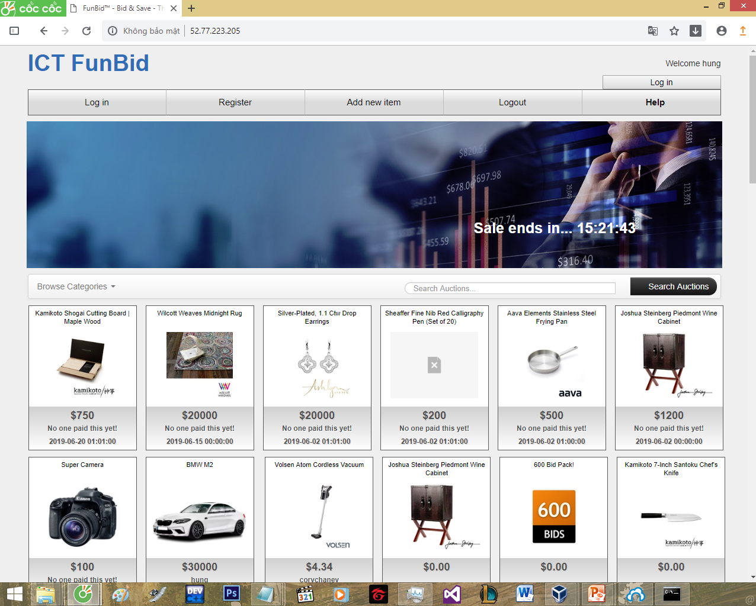
1. System overview
A system for bidding items
+ Higher bidder win
+ Chance to win the product with a low price!

Slide 4
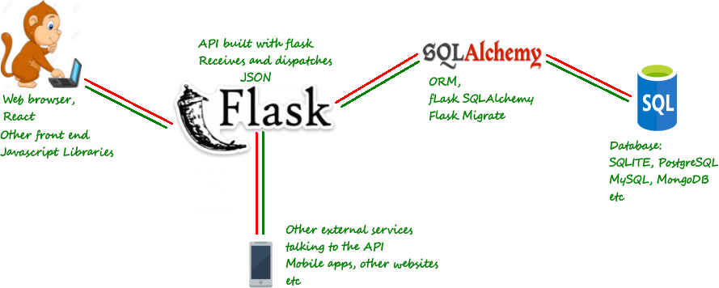
2. System architecture

Slide 5
3. Project installation
Database server: mysql
API server: python3, flask, pyjwt

Slide 6
4. Teamwork
Lê Xuân Hưng: 33% (front-end, tester, deploy)
Trần Tùng Dương: 33% (back-end, database design)
Nguyễn Ngọc Quý: 33% (architecture design, back-end)

Slide 7
5.Challenge
*Celery Back gorund tasks:
activate auction when start time is due
Close fuction after a time interval(default 24 hours)
task = chain(activate.s(status).set(eta=start_time), deactivate.s().set(eta=end_time))().apply_async()
*Datetime synchronization with the Internet

Slide 8
6. Demo

Slide 9
Thank you!

